Slide 1
Economics Project-1 Group-3

Slide 2
Aneri Sheth - 1401072
Hemil Gurjar - 1401002
Himanshu Budhia - 1401039
Janki Desai - 1401103
Kunal Suba - 1401097
Palash Hariyani - 1401101
Rajvi Prajapati - 1401033
Rupande Shastri - 1401102

Slide 3
Acknowledgement
This project was to try something out of our domain. Economics for an engineering bunch of students is something which can be disturbing but it wasn’t. Constant Support from Faculty Ms. Rita Sharma and our grader Anmol was highly appreciated and we all are sincerely thankful to let us discover this new world of economics and dirty our hands in it too. Madam as well as Anmol were available to solve our questions and even helped us a lot in selecting the topics for our project.
A sincere Thanks to both of them! ☺
Even the manager at Shiva’s Mr. Viky and manager at Shambhu’s Mr. Umesh Desai were equally helpful in providing the data and information about their respective franchise.

Slide 4
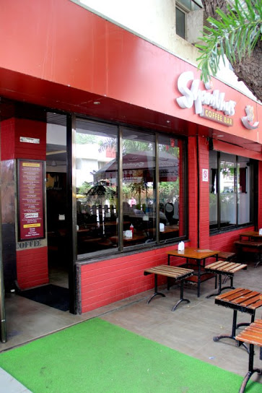
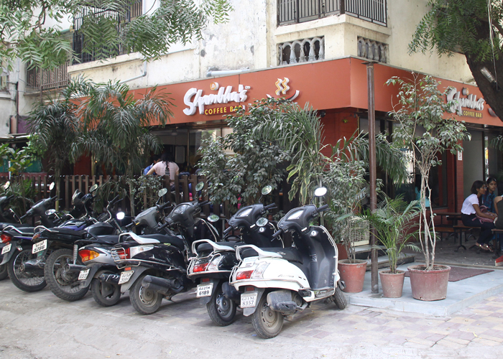
History of Shambhu’s
Started as a lorry near HL college by Shambhu Singh, a 20 year old migrant from Rajasthan with only Rs.5000 in hand
Their best selling product - Cold and Hot coffee
The Coffee started at Rs.15 and Now is Rs.50
25% revenue from coffee.

Slide 5
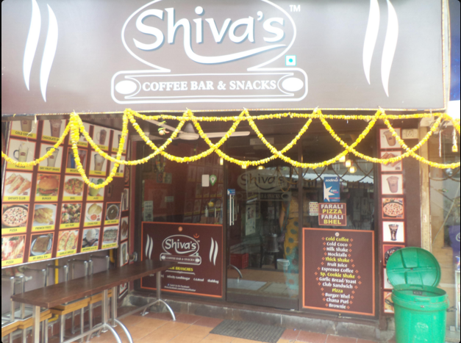
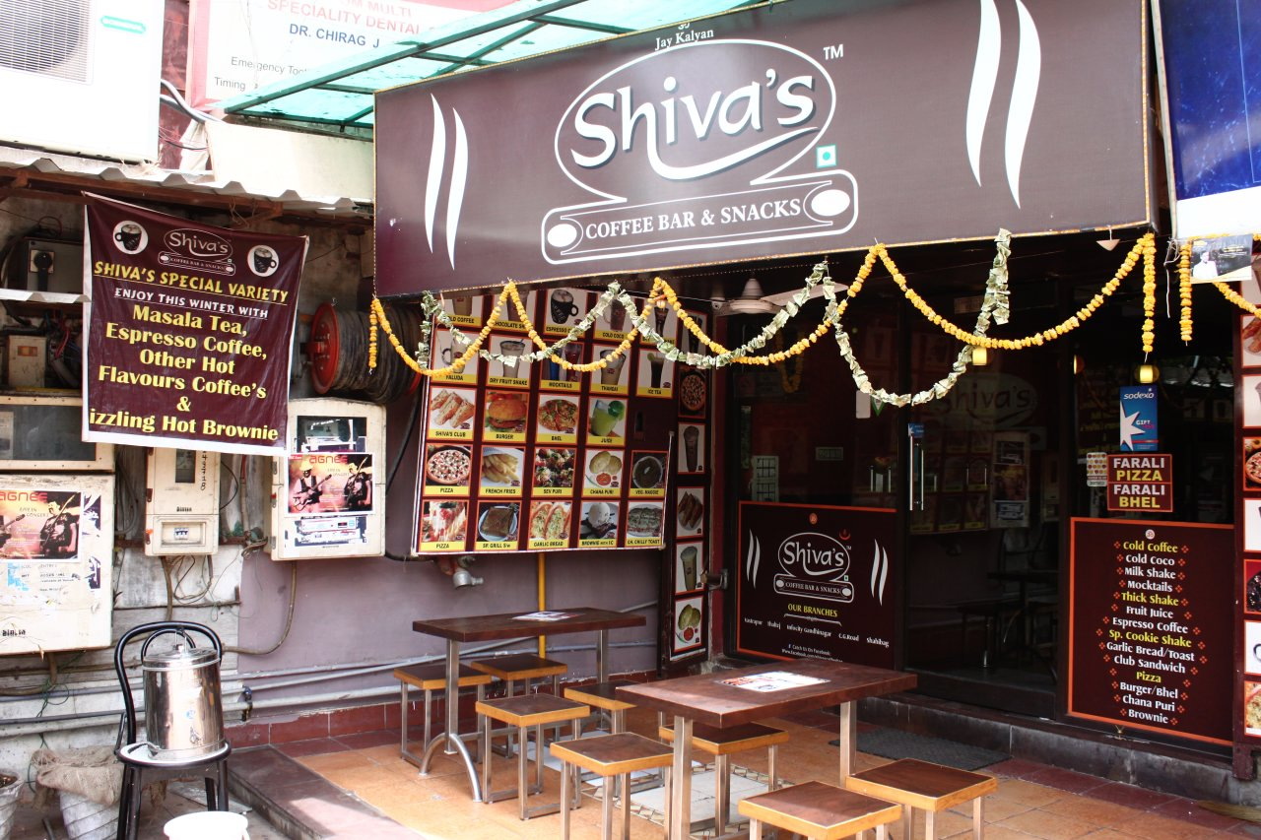
History of Shiva’s
Started around 10 years ago
The owner was brother in law of the owner of Shambhu's and worked with him.
They had their first venture as a stall at CG Road Municipal Market from which they moved to Vastrapur Lake nr. Jay Bhavani in Sardar Complex.

Slide 6
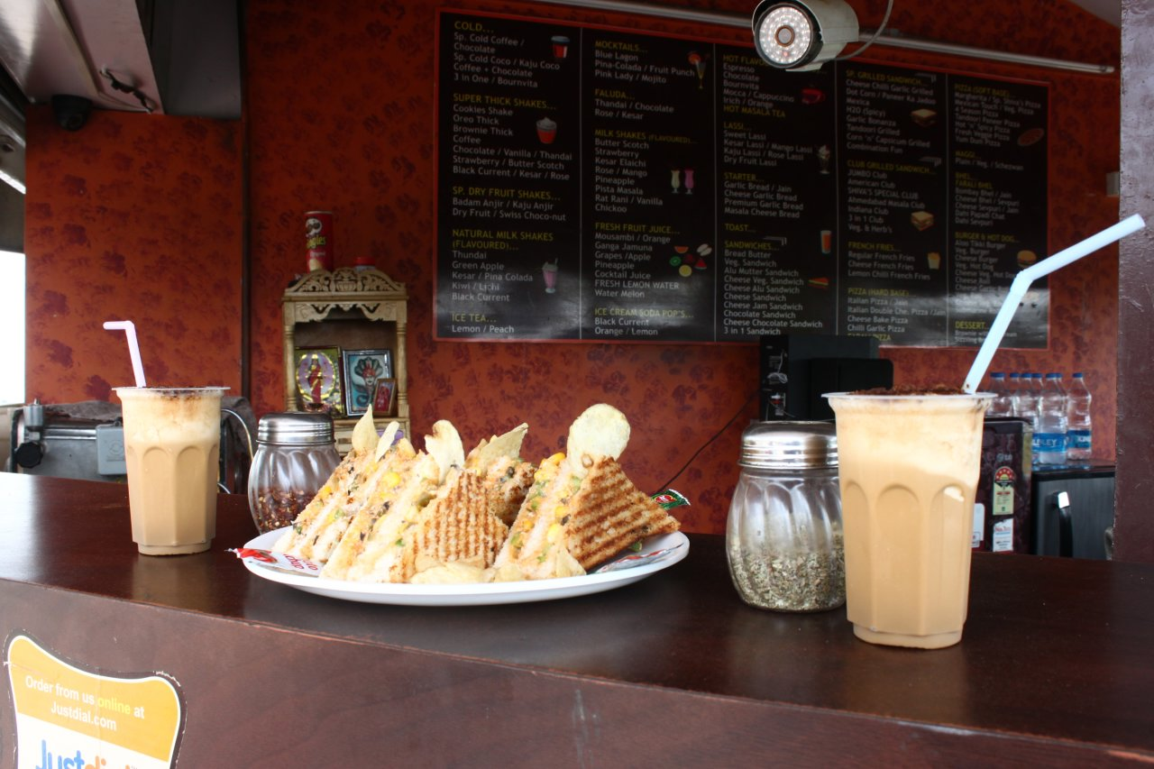
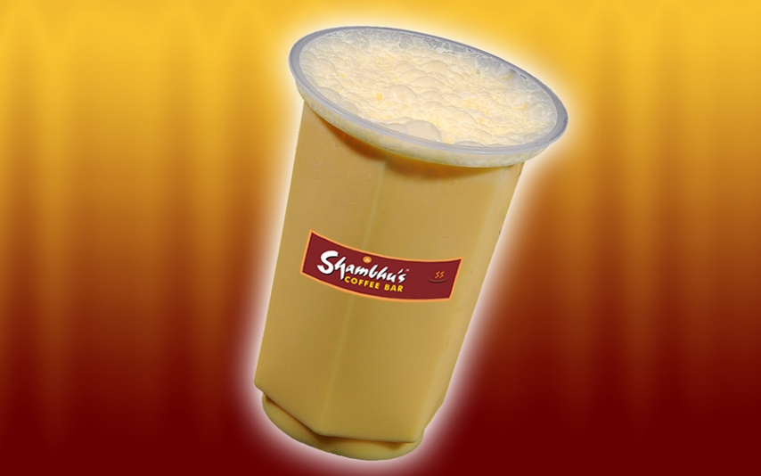
The Product Story – Cold Coffee
Shambhu’s
Shiva’s
The chief beverages are Cold Coffee and cold coco. The products most demanded are Pizza, Sandwiches and Panini.
Cold Coffee is the product whose demand is the highest. Other demanded products include Pizza, Sandwiches and Coco.

Slide 7

Basic Concept of Demand and Supply
Demand refers to how much (quantity) of a product or a service is desired by buyers and also considering the purchasing power of the customers along with the willingness to buy that product.
Supply represents how much the market can offer. The quantity supplied refers to the amount of a certain goods or services producers or service providers are willing to supply when receiving a certain price and profit.

Slide 8
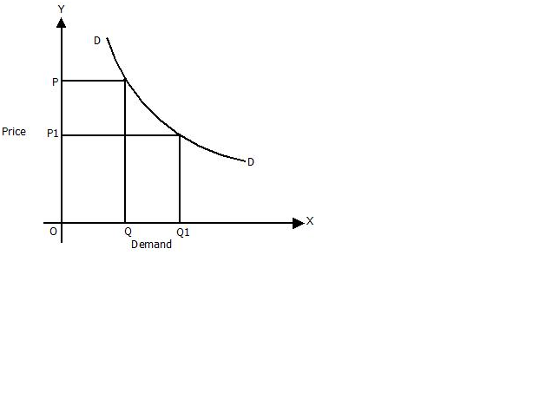
Demand
Law of demand states that keeping other factors constant, the price of goods and services is inversely proportional to the quantity demanded.

Slide 9
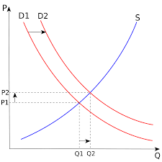
Supply
The law of supply states that the price of a product is directly proportional to the quantity supplied keeping all other factors constant.

Slide 10
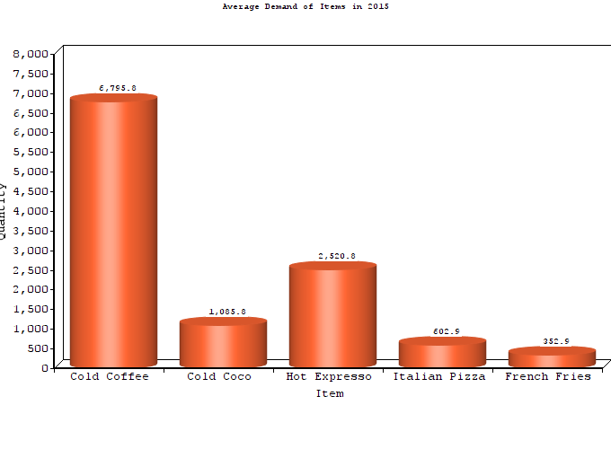
Demand of Shambhu’s

Slide 11
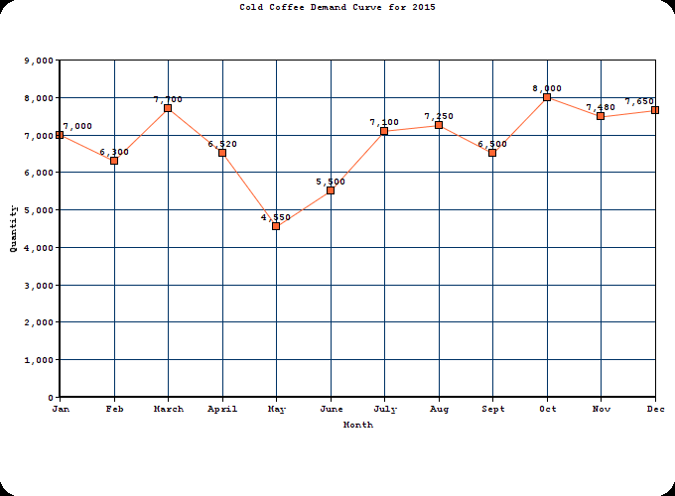
Shambhu’s Cold Coffee Sales During Year 2015 Month wise Report

Slide 12
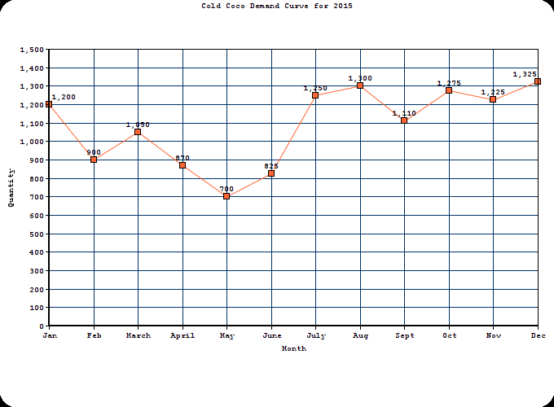
Shambhu’s Cold Coco Sales During Year 2015 Month wise Report

Slide 13
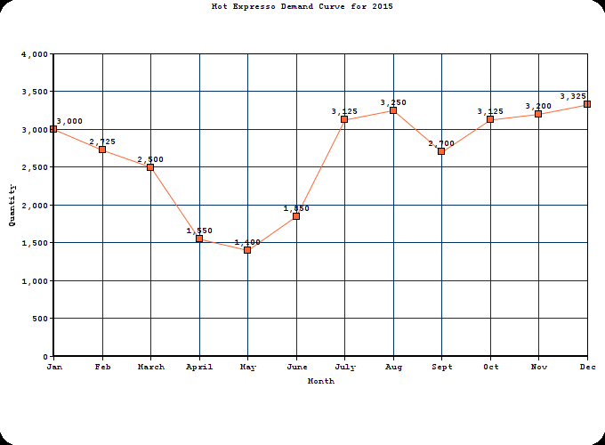
Shambhu’s Hot Espresso Sales During Year 2015 Month wise Report

Slide 14
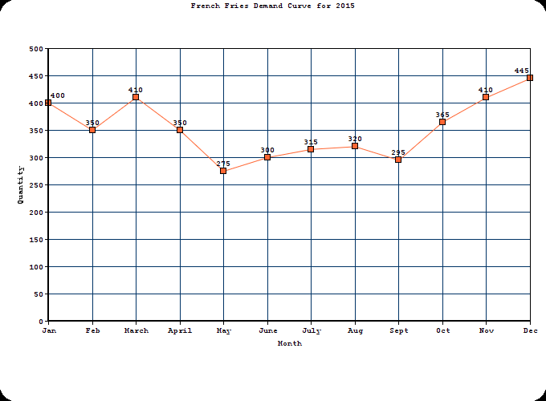
Shambhu’s French Fries Sales During Year 2015 Month wise Report

Slide 15
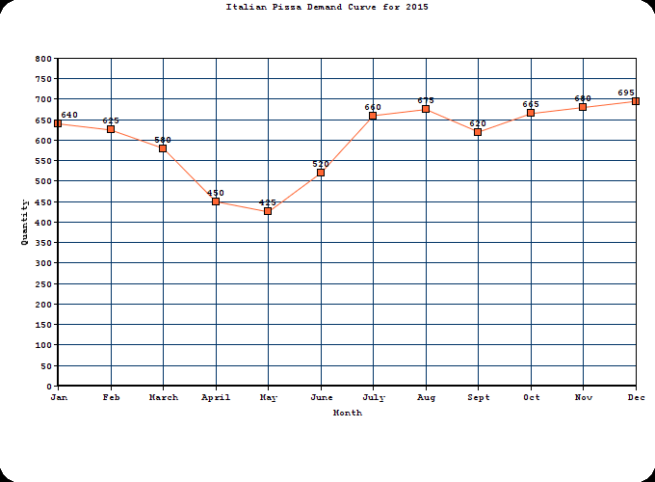
Shambhu’s Italian Pizza Sales During Year 2015 Month wise Report

Slide 16
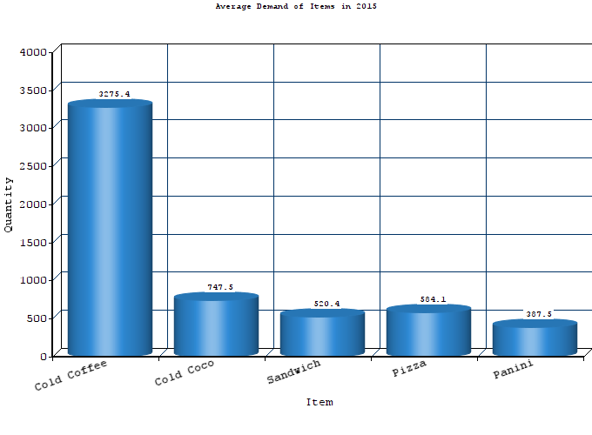
Demand of Shiva’s

Slide 17
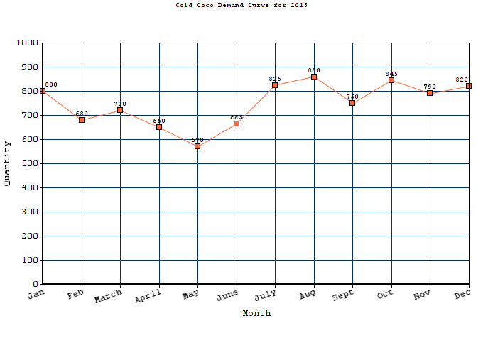
Shiva’s Cold Coco Sales During Year 2015 Month wise Report

Slide 18
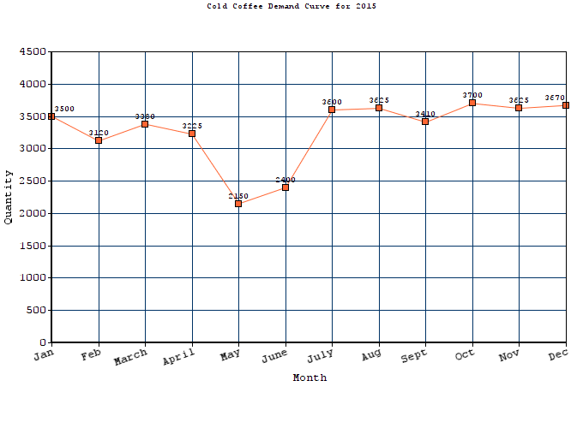
Shiva’s Cold Coco Sales During Year 2015 Month wise Report

Slide 19
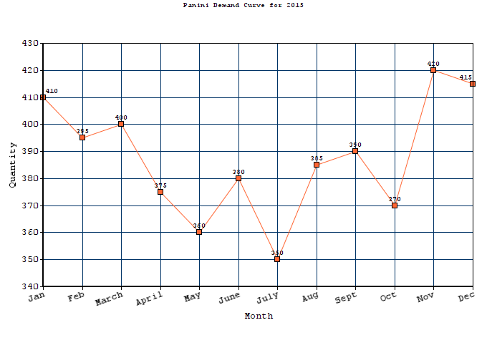
Shiva’s Panini sales During Year 2015 Month wise Report

Slide 20
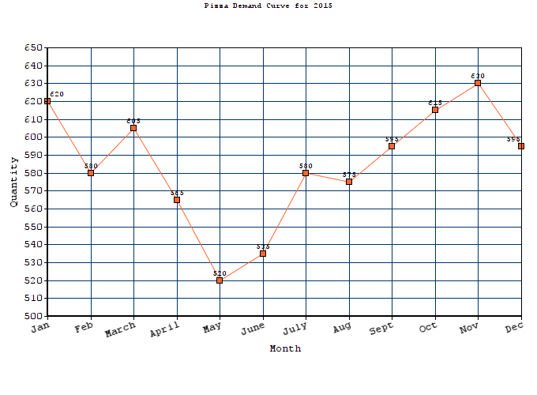
Shiva’s Pizza Sales During Year 2015 Month wise Report

Slide 21
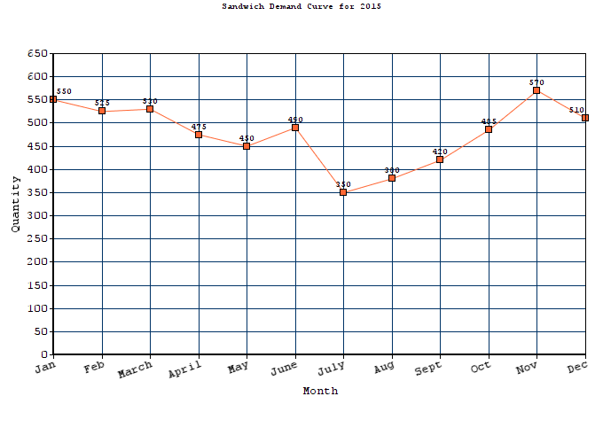
Shiva’s Sandwich Sales During Year 2015 Month wise Report

Slide 22
UPTIL NOW, WE SAW ONLY FIGURES AND GRAPHS. BUT WHAT CONTROLS THESE NUMBERS? WHAT FACTORS INFLUENCE THE SALES TO RISE AND DIP? LET’S FIND OUT ☺

Slide 23
Factors affecting Demand!

Slide 24
Price of relative goods
Demand for cold coffee is influenced by the change in price of relative goods. For example, change in price of milk changes the price of coffee and hence the demand.
Now if the price of coffee increases from Rs 30 to Rs 40 whereas the price of other aerated drinks remains the same then the demand for cold coffee may gradually fall down

Slide 25
Taste and preference
The taste of cold coffee is maintained the same which results in the same demand of cold coffee. Also, this helps in earning profit since quality and taste remains the same whereas aerated drinks are harmful so that brings consumers towards these beverages.

Slide 26
Time
Time is an important factor that affects the demand. e.g. the demand for cold coffee is maximum during Navratri and the least during summer break and it also changes during the time of the day. Beverages are demanded more in evening and afternoon whereas food items are demanded more at night.

Slide 27
Coupons, Offers and Combos
Marketing and Advertisement of their franchise on various platforms leads to increase in demand like coupondunia, groupon, etc.
Age group
The main consumers are college going students and the youth which doesn’t affect the demand much, and so we can see that May –June has low demand sue to vacations. Even corporate youth are often found at both of these places during break hours.

Slide 28
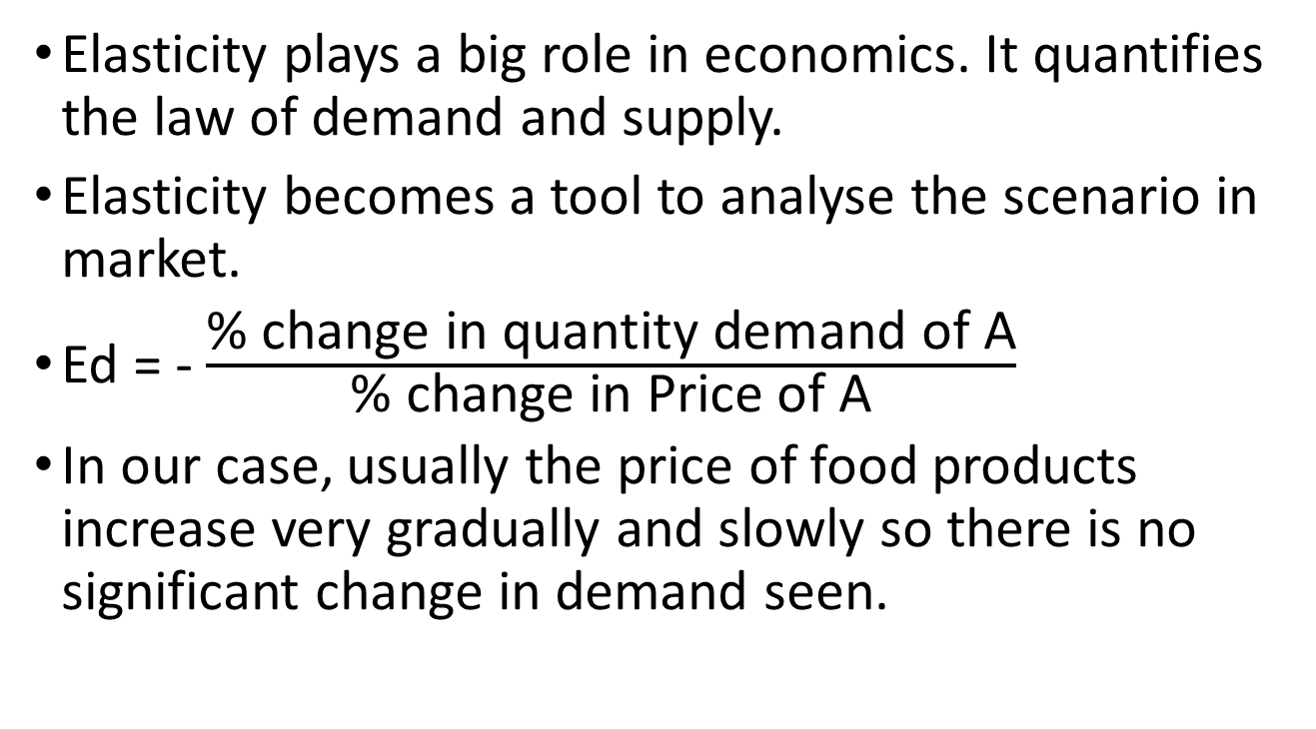
Price Elasticity Of Demand (Ed)
Elasticity plays a big role in economics. It quantifies the law of demand and supply.
Elasticity becomes a tool to analyse the scenario in market.
Ed = - $\frac{\text{\% }\text{change} \text{in} \text{quantity} \text{demand} \text{of} \text{A}}{\text{\% }\text{change} \text{in} \text{Price} \text{of} \text{A}}$
In our case, usually the price of food products increase very gradually and slowly so there is no significant change in demand seen.

Slide 29
Cross Elasticity of Demand (complimentary)
Demand elasticity of complimentary goods is: Price of final product is affected by significant price change of it’s raw materials and constituent products.
For eg: Both Shambu’s and Shiva’s had a price change on their beverages and food items when milk, butter and cheese prices were increased.
Both of them use Amul Gold from retail outlets.

Slide 30
Factors affecting Price!

Slide 31
1) Infrastructure
The production increased which led to new coffee making machines, tools for the other food items, which in turn resulted in price hike over a small percent.
2) Ambience
The overall look of Shambhu's evolved in span of 20 years.
New glasses, plates, tables and a friendly atmosphere was created keeping in mind the target audience i.e. college-going-students.
Similarly, the interior of Shiva’s was redesigned a couple of years back after which they had a price hike.
3) Customers
To cater to new customers and increase in sales, the prices were increased to hire required staff and increase their number of outlets.

Slide 32
4) Quality
Customers did not mind a slight increase in price owing to the fact that their quality remained intact, and the stronghold of both the franchise lies in their quality of food they serve.
5) Raw Materials
As the price of the raw materials such as milk, cheese and other goods increased, they were compiled to change their price to keep the constant taste and quality of their brand.

Slide 33
Some Interesting Stats!

Slide 34
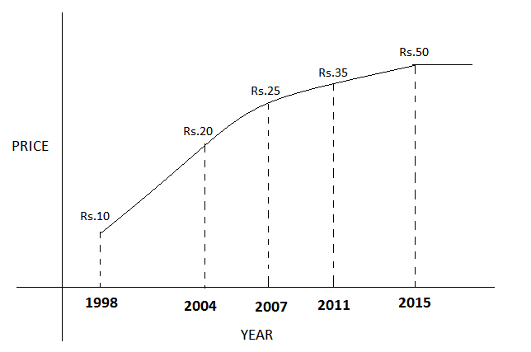
Shambhu’s Cold Coffee Price Change with Time

Slide 35
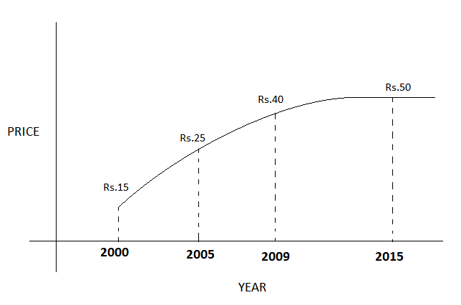
Shiva’s Cold Coffee Price Change with Time

Slide 36
Economy of Shiva’s
Cold Coffee Prices :
Municipal Market ₹15
Lorry at Vastrapur (with shambhu’s hording☹) ₹25
Shop Upgraded, Price Increased in 2009 ₹40
Currently ₹50

Slide 37
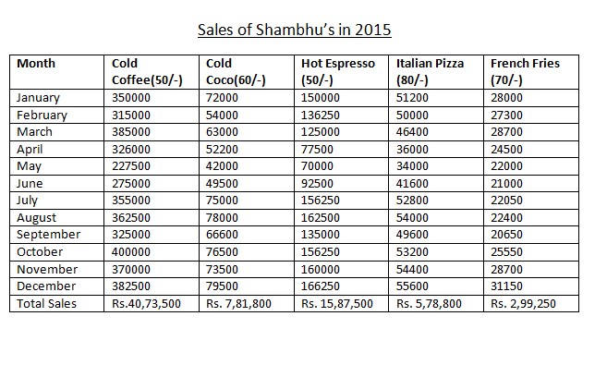
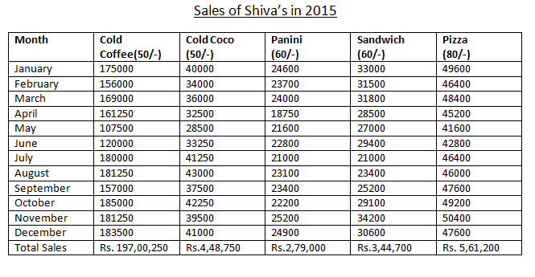

Slide 38
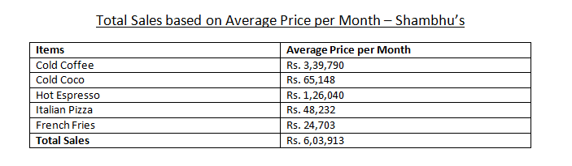
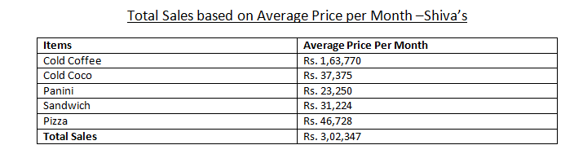
Sales of Shambhu’s and Shiva’s

Slide 39
Some Facts about Shiva’s!
Actual Cost of production is 35% of what they are selling at.
Coupon partners are foodpanda, jackpot and little.
They take party orders which gradually increases in winters. They also supply beverages like hot espresso, cold coffee to other restaurants and meeting places.
They decide their menu according to the location of the franchise. Eg: Gota is a family restaurant where even Chinese and Punajbi are served whereas others are just a coffee café.
At vastrapur, people tend to go more in afternoons whereas at SG Highway, evenings are busier.

Slide 40
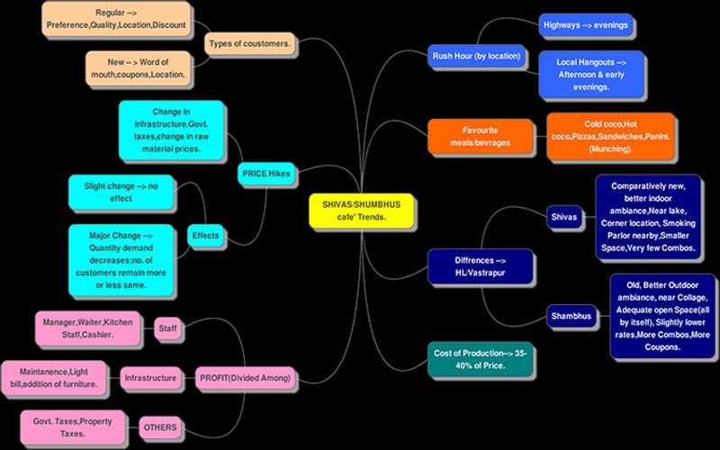

Slide 41
Ratings and Reviews!

Slide 42
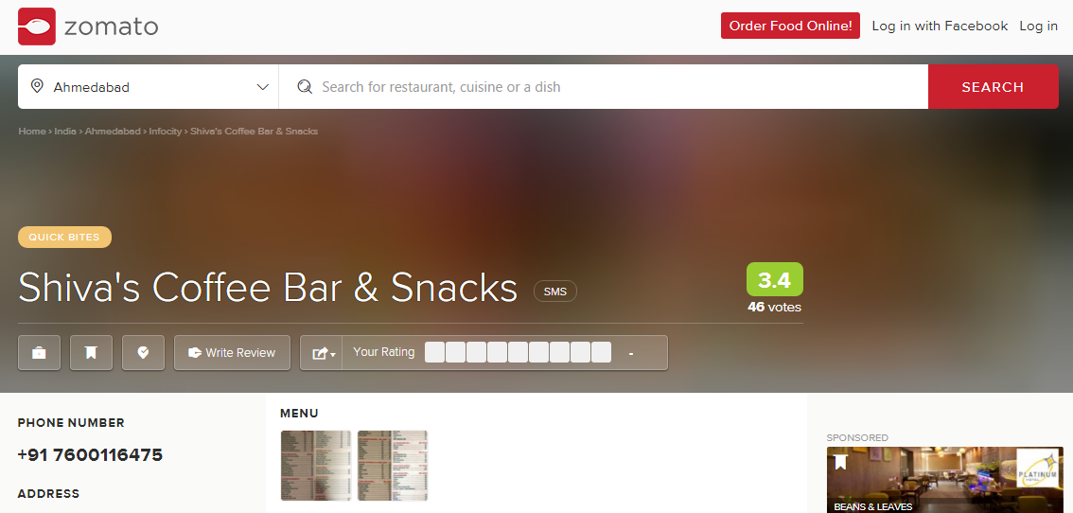

Slide 43
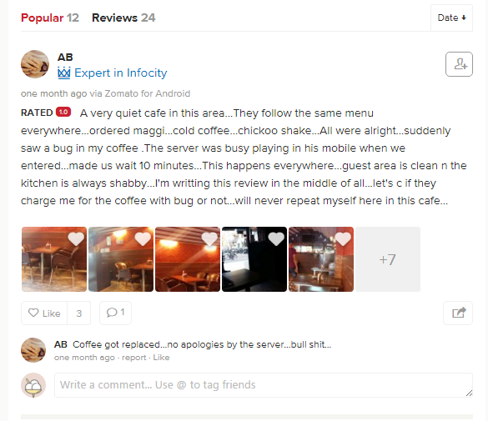
Shiva’s Review

Slide 44
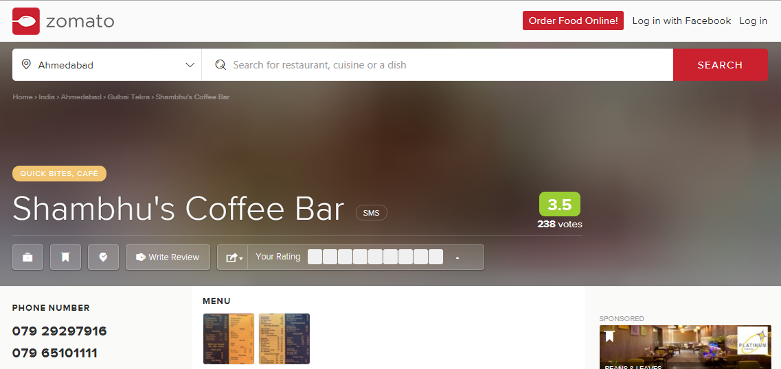

Slide 45
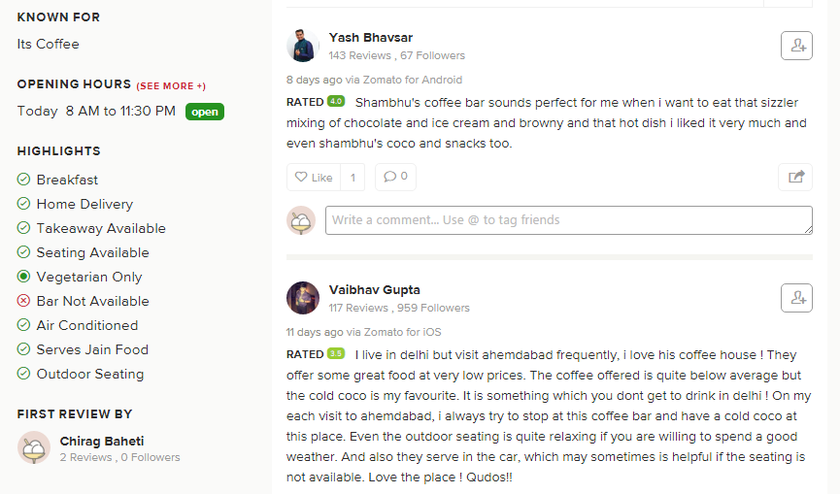
Shambhu’s Review

Slide 46
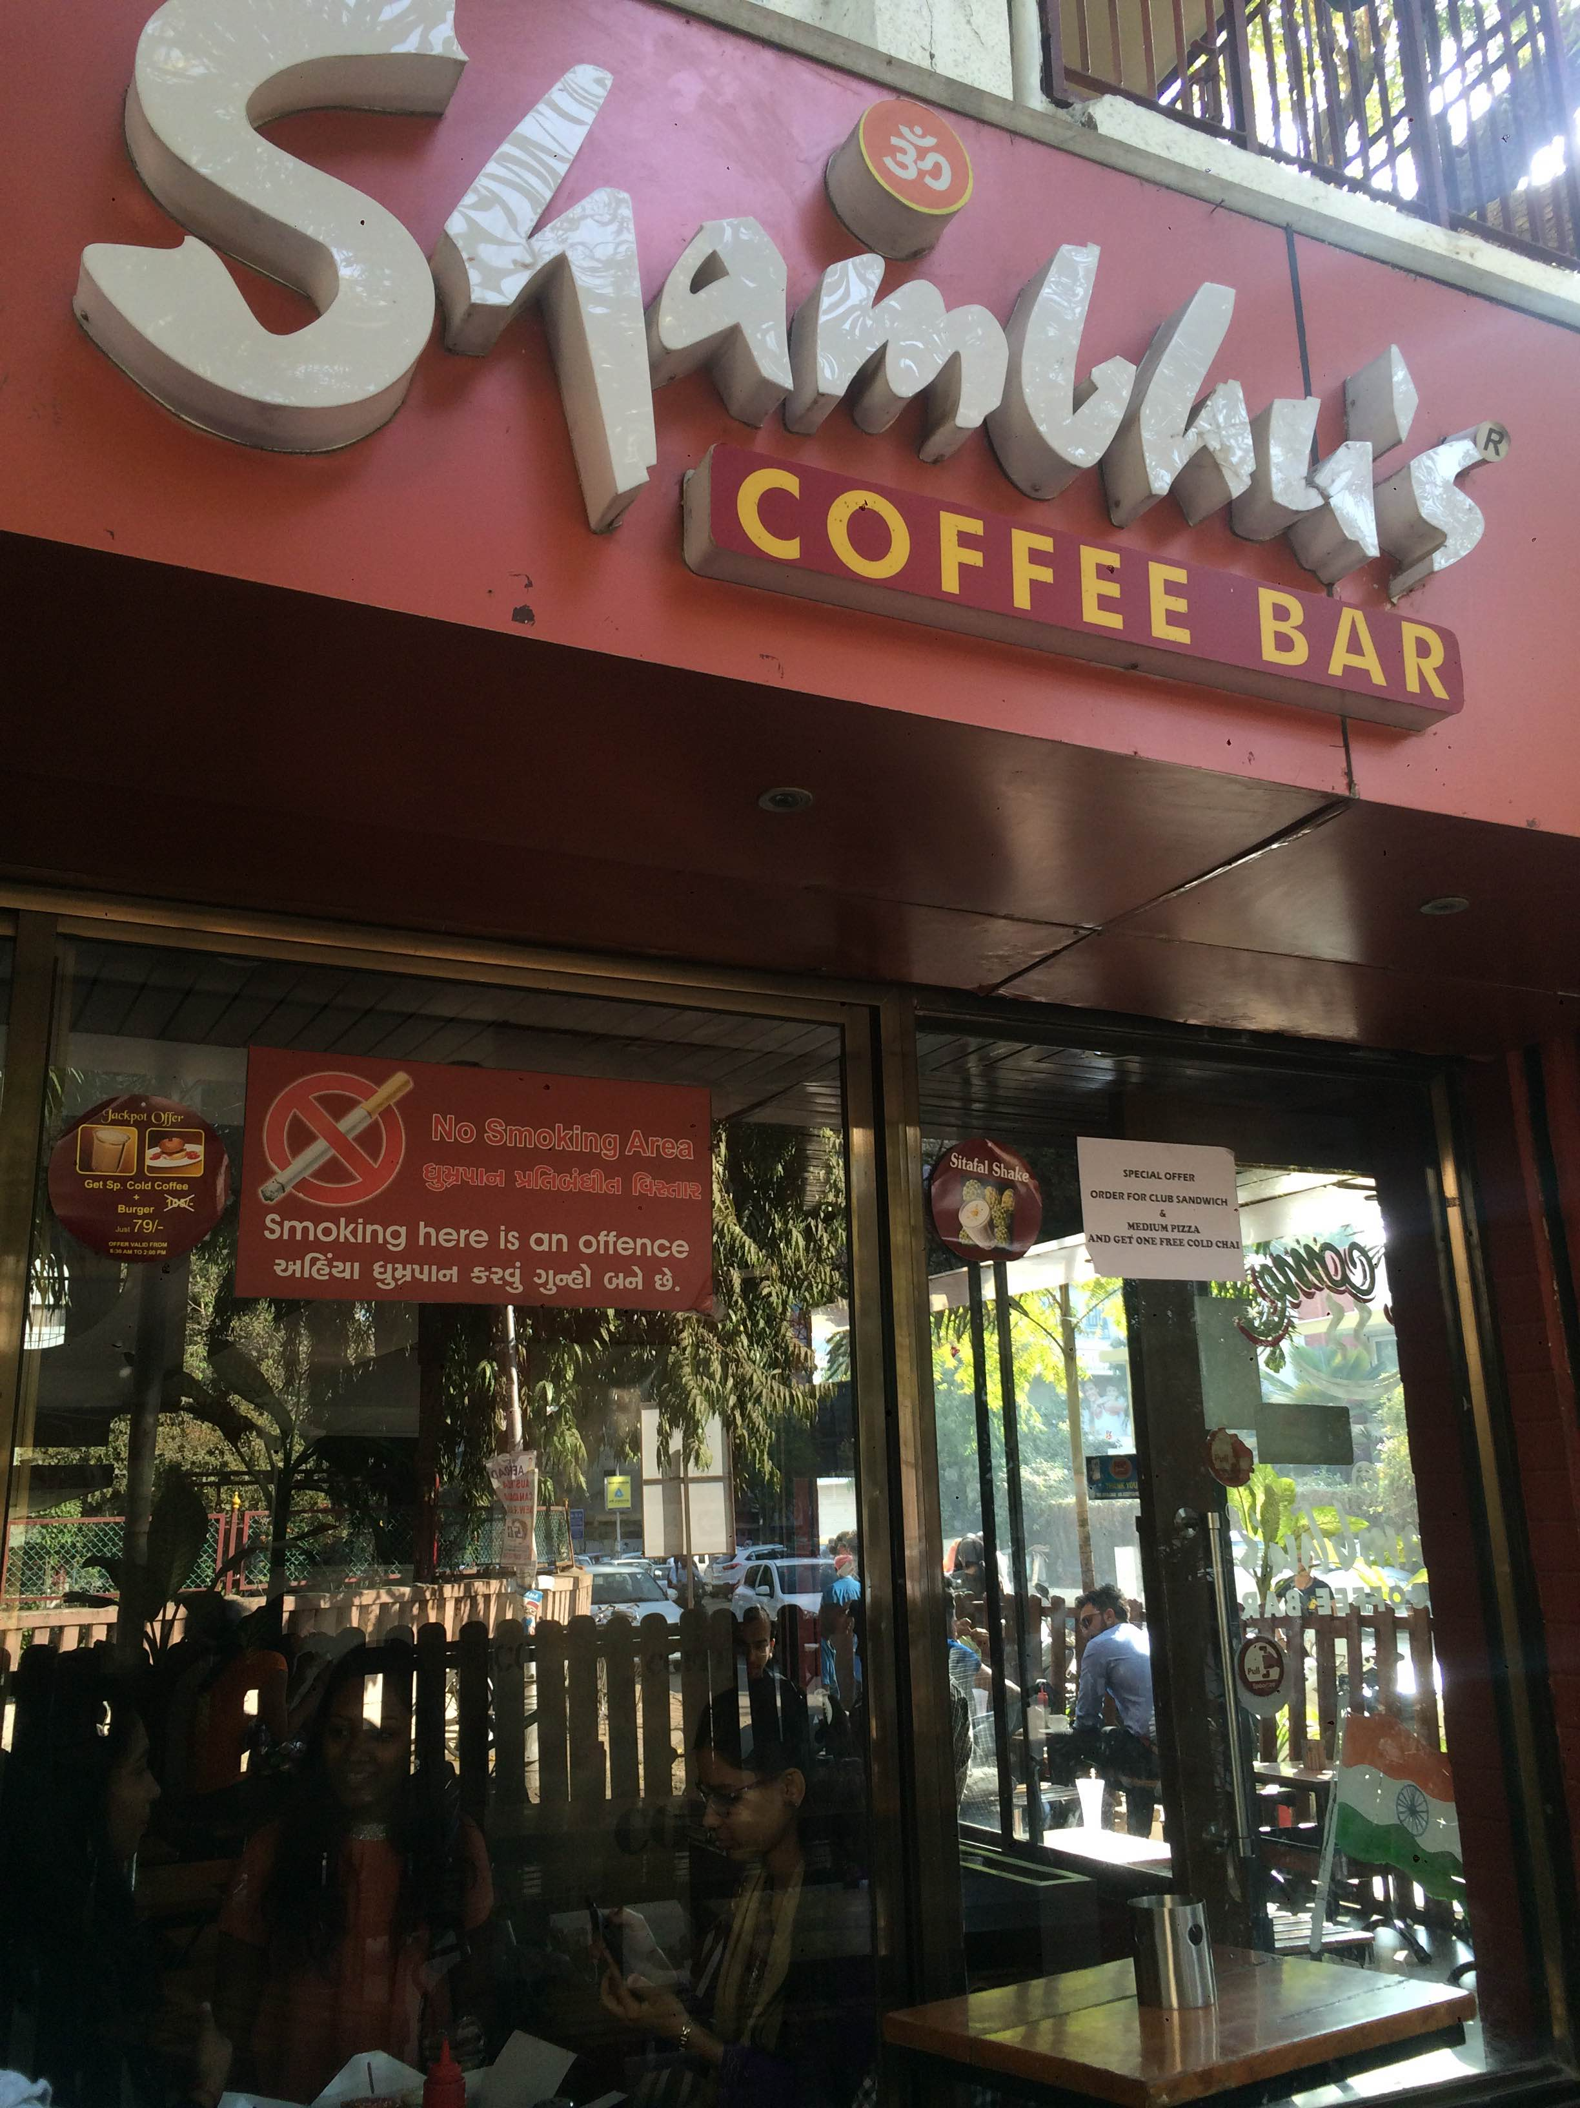
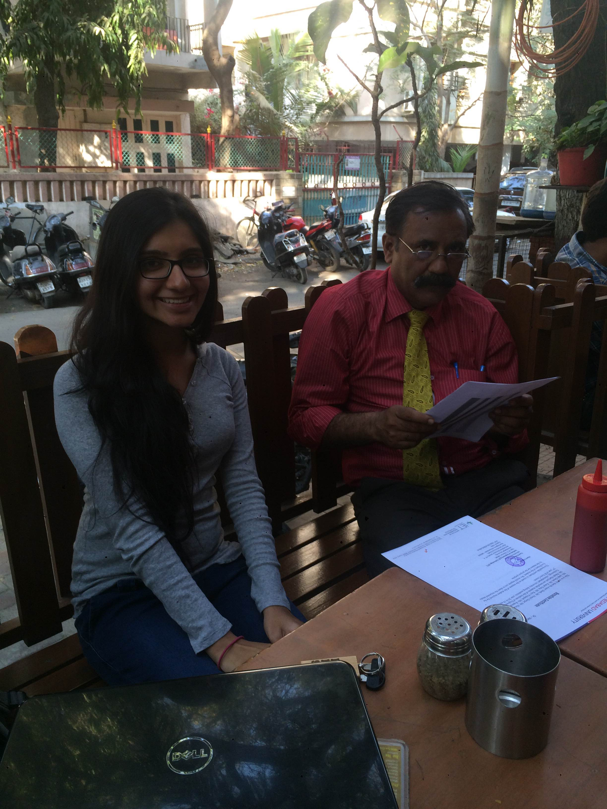

Slide 47
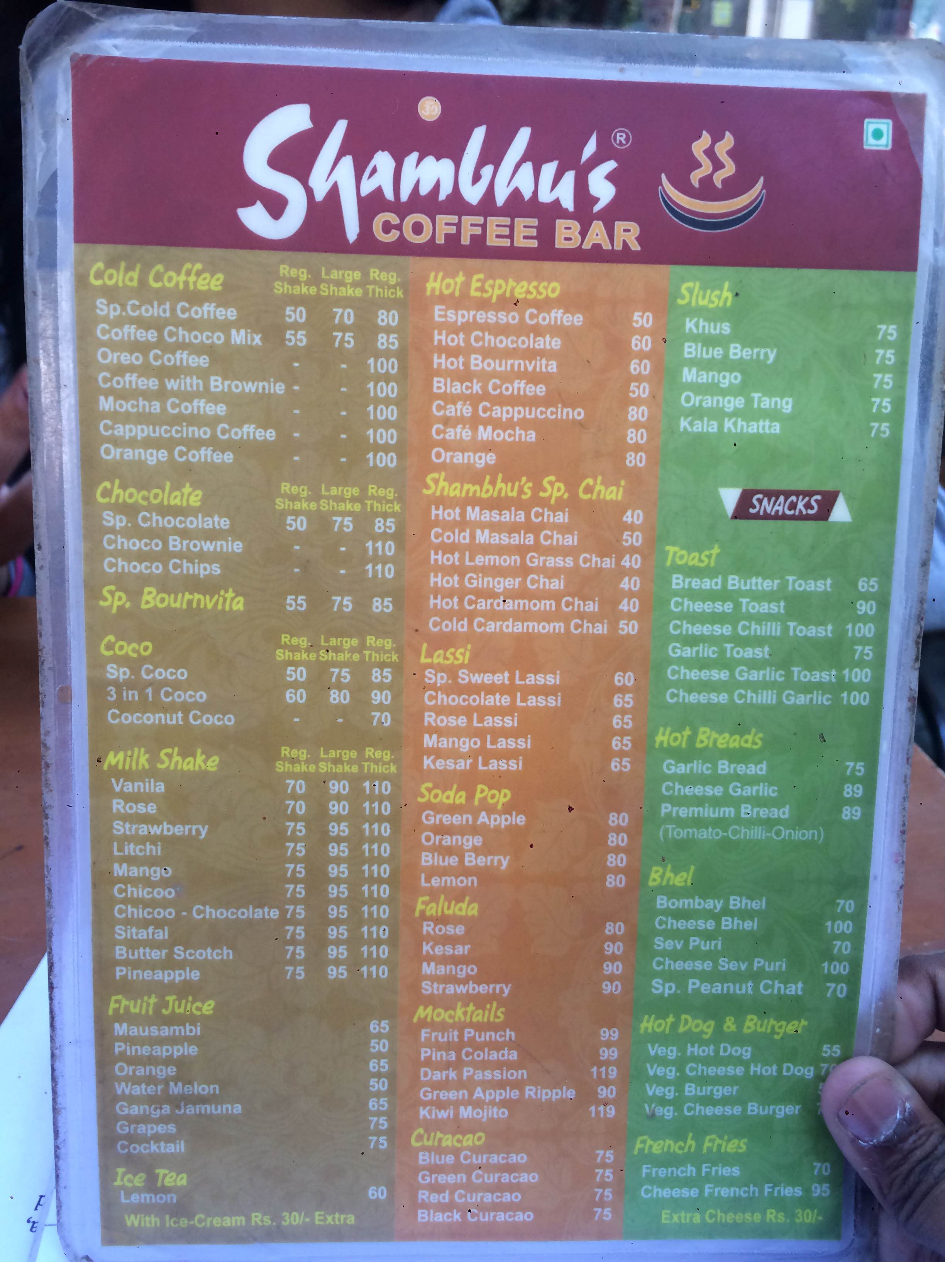
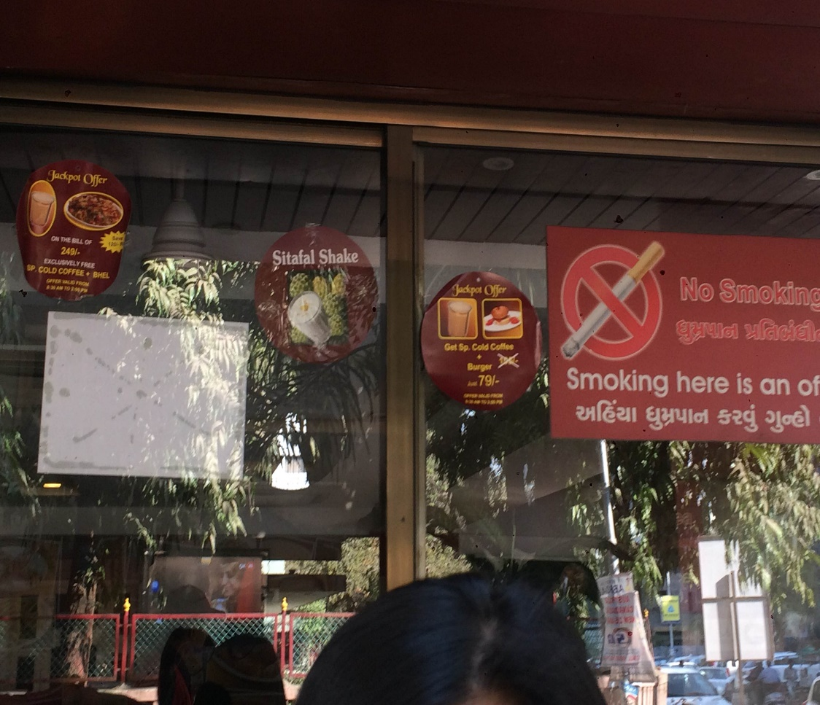

Slide 48
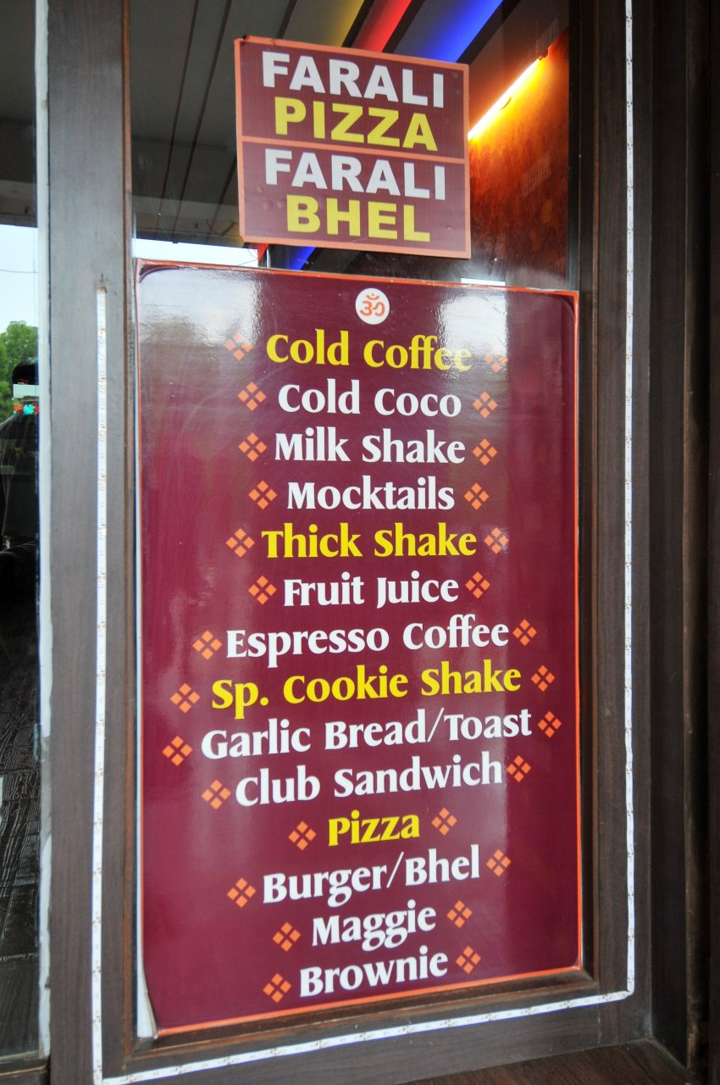
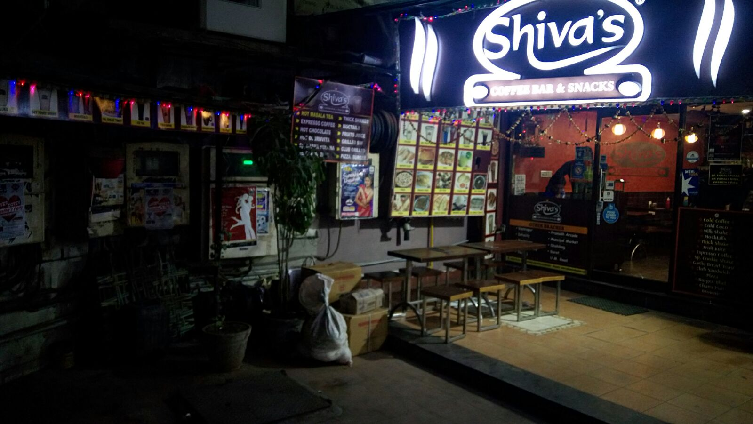
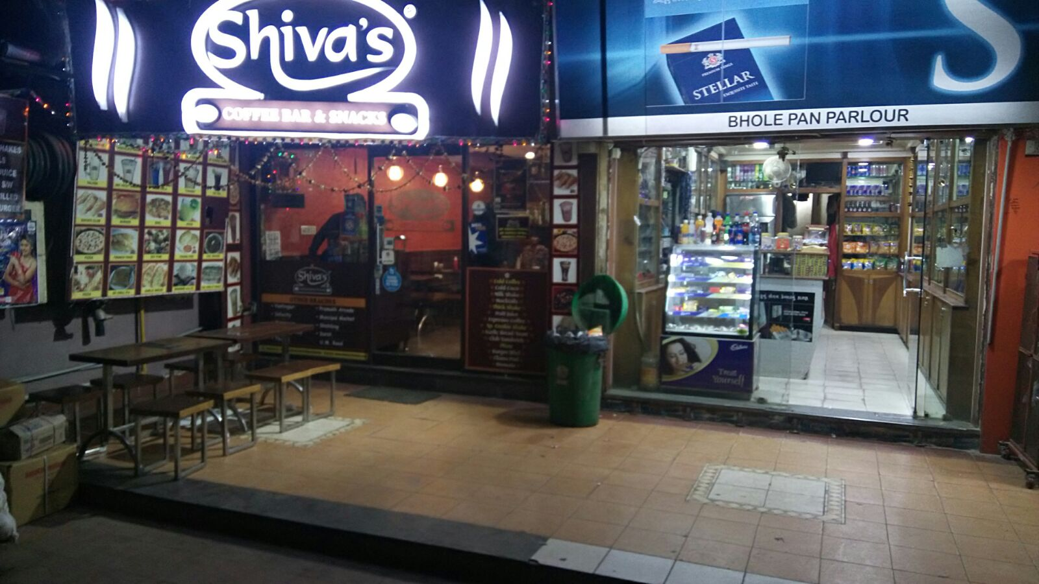

Slide 49
ThankYou!

